Slide 1
DECISION TREE
&
RANDOM FOREST

Slide 2
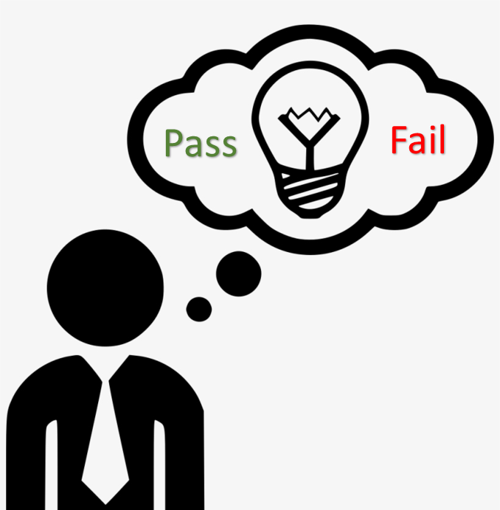
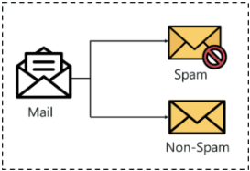
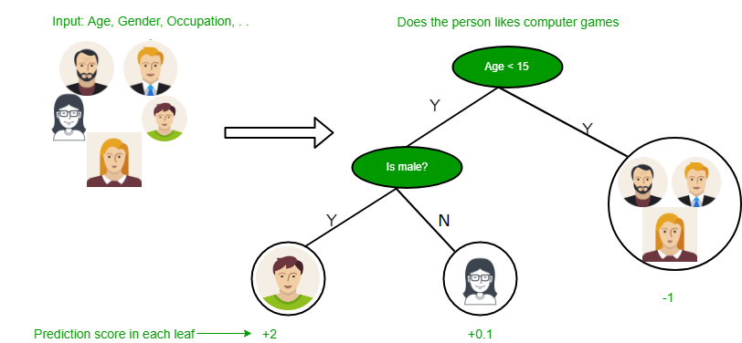
PROBLEM
How to know which mail is spam or not ?
Which person is likely to get the job ?
Should i take the job or not ?
How to detect credit card fraud ?
How to predict cardiovascular disease?
Will i pass the test or not ?

Slide 3
SOLUTION
- Classification
Definition -
Classification is the process of dividing the database into different categories or groups by adding label . It help in predicting the label or category of the given input variables.
Example-
Whether it is raining or not and the answer can either be yes or no.
The bank needs to analyze whether giving a loan to a particular customer is risky or not.
The risk of having some side effect on a patient after getting a particular surgery - also a yes no question.
etc.

Slide 4
When to Use Classification Method ?
When need of easily-interpretable models .
In need of predicting discrete class labels (i.e. Male or Female, True or False, Spam or Not Spam).
In another word -
“ When its about identifying group membership “.

Slide 5
Few of the terminologies encountered in classification:
Classifier: An algorithm that maps the input data to a specific category.
Classification model: A classification model tries to draw some conclusion from the input values given for training. It will predict the class labels/categories for the new data.
Feature: A feature is an individual measurable property of a phenomenon being observed.
Binary Classification: Classification task with two possible outcomes. Eg: Gender classification (Male / Female).
Multi-class classification: Classification with more than two classes. In multi class classification each sample is assigned to one and only one target label. Eg: An animal can be cat or dog but not both at the same time.
Multi-label classification: Classification task where each sample is mapped to a set of target labels (more than one class). Eg: A news article can be about sports, a person, and location at the same time.

Slide 6
Types of Classification
Decision Tree
Random Forest

Slide 7
Decision Tree
Definition -
Decision tree learning is a method commonly used in data mining. The goal is to create a model that predicts the value of a target variable based on several input variables.
A decision tree is a simple representation for classifying examples.
Example-
Whether it is raining or not and the answer can either be yes or no.
The bank needs to analyze whether giving a loan to a particular customer is risky or not.
The risk of having some side effect on a patient after getting a particular surgery - also a yes no question.
etc.

Slide 8
When TO Use Decision Tree
Feature values are preferred to be categorical. If the values are continuous then they are discretized prior to building the model.
Records are distributed recursively on the basis of attribute values.
Order to placing attributes as root or internal node of the tree is done by using some statistical approach.

Slide 9
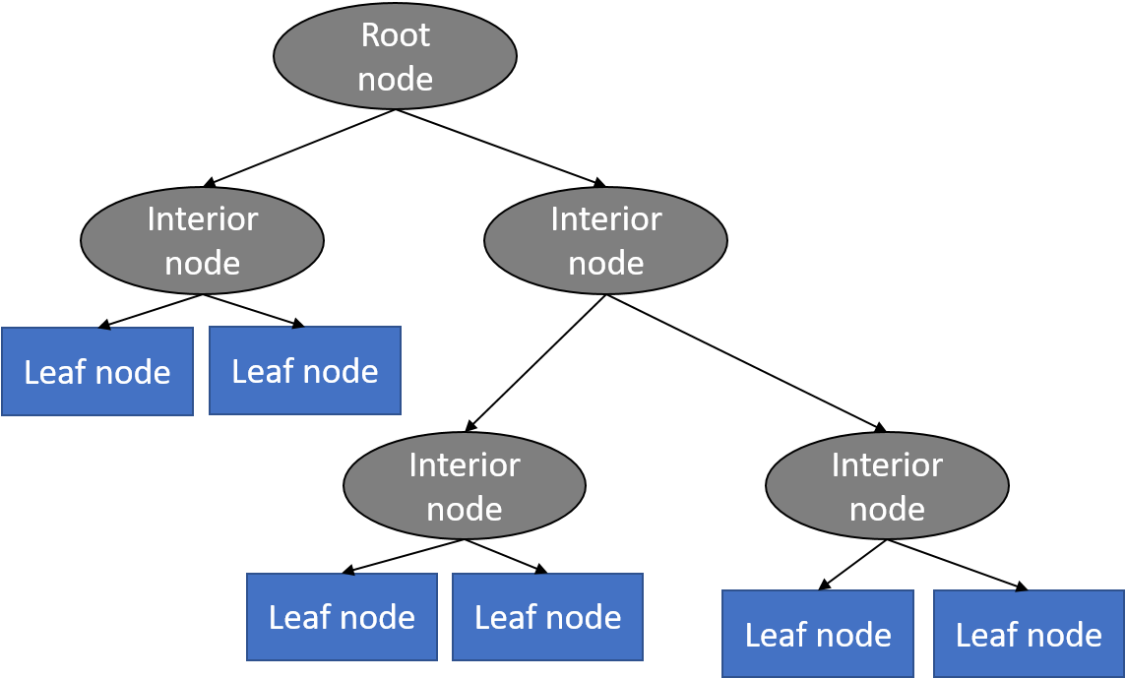
Model
A decision tree typically starts with a single node, which branches into possible outcomes. Each of those outcomes leads to additional nodes, which branch off into other possibilities. This gives it a treelike shape.
Types of node -
Layer 1 - Root node :The topmost decision node in a tree which corresponds to the best predictor called root node.
Layer 2 - Decision\Internal node :A decision node (e.g., Outlook) has two or more branches
Layer 3 - Leaf node :Leaf node represents a classification or decision.

Slide 10
Algorithm
We have many algorithms to build decision trees, but ID3 algorithm is the famous one .
ID3 Algorithm
ID3 stands for Iterative Dichotomiser 3 and is named such because the algorithm iteratively (repeatedly) dichotomizes(divides) features into two or more groups at each step.
ID3 is invented by Ross Quinlan used to generate a decision tree from a dataset.
It is a classification algorithm that follows a greedy approach by selecting a best attribute that yields maximum Information Gain(IG) or minimum Entropy(H).

Slide 11
What is Entropy and Information gain?
Entropy is a measure of the amount of uncertainty in the dataset S. Mathematical Representation of Entropy is shown here -
H ( S ) = ∑ c ∈ C − p ( c ) l o g 2 p ( c )
Where,
S - The current dataset for which entropy is being calculated(changes every iteration of the ID3 algorithm).
C - Set of classes in S {example - C ={yes, no}}
p(c) - The proportion of the number of elements in class c to the number of elements in set S.
In ID3, entropy is calculated for each remaining attribute. The attribute with the smallest entropy is used to split the set S on that particular iteration.
Entropy = 0 implies it is of pure class, that means all are of same category.

Slide 12
Information Gain IG(A) tells us how much uncertainty in S was reduced after splitting set S on attribute A. Mathematical representation of Information gain is shown here -
I G ( A , S ) = H ( S ) − ∑ t ∈ T p ( t ) H ( t )
Where,
H(S) - Entropy of set S.
T - The subsets created from splitting set S by attribute A such that
S = ⋃ t ϵ T t
p(t) - The proportion of the number of elements in t to the number of elements in set S.
H(t) - Entropy of subset t.
In ID3, information gain can be calculated (instead of entropy) for each remaining attribute. The attribute with the largest information gain is used to split the set S on that particular iteration.

Slide 13
Steps in ID3 algorithm?
The steps in ID3 algorithm are as follows:
Calculate entropy for dataset.
For each attribute/feature. A. Calculate entropy for all its categorical values. B. Calculate information gain for the feature.
Find the feature with maximum information gain.
Repeat it until we get the desired tree.

Slide 14
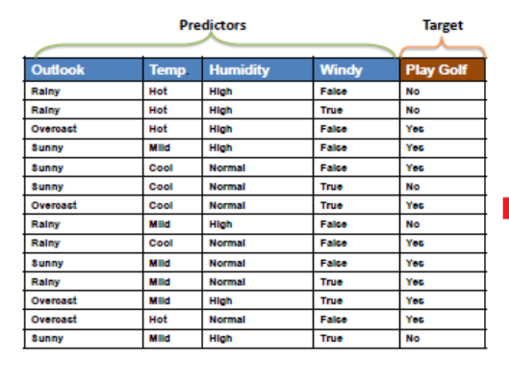
Working
Example -
Consider we have a tabular data and we are going to make a decision tree for that from scratch .

Slide 15
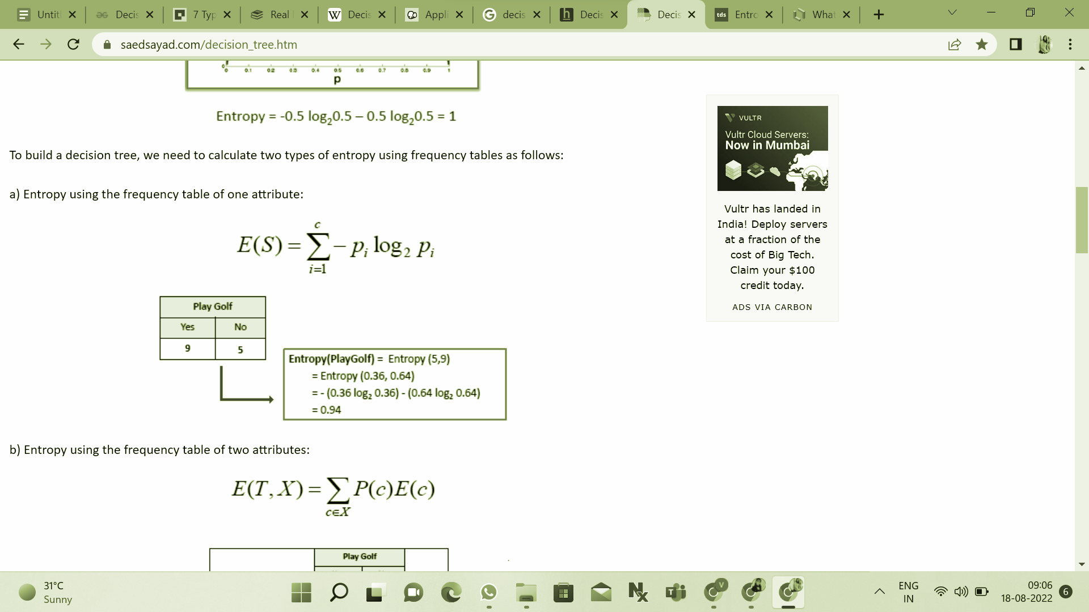
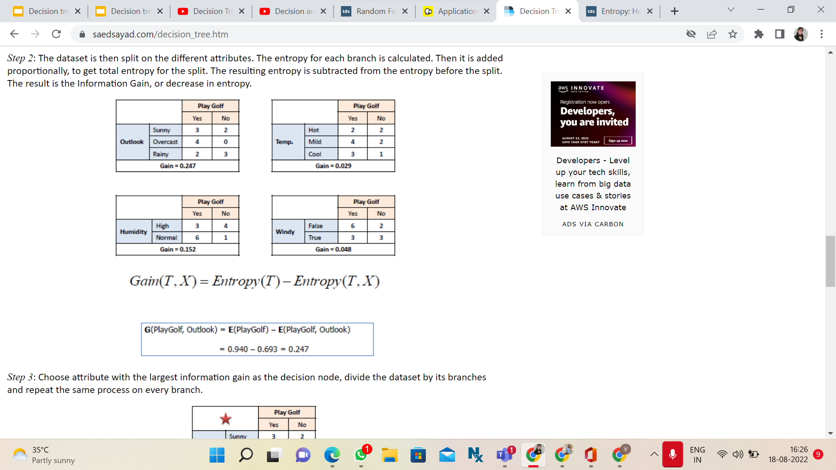
Theory TO Practical (Building Decision Tree)
Step 1 - Calculate entropy of target
Step 2 - Calculate the entropy for each branch .
Step 3- Then it is added proportionally, to get total entropy for the split.

Slide 16
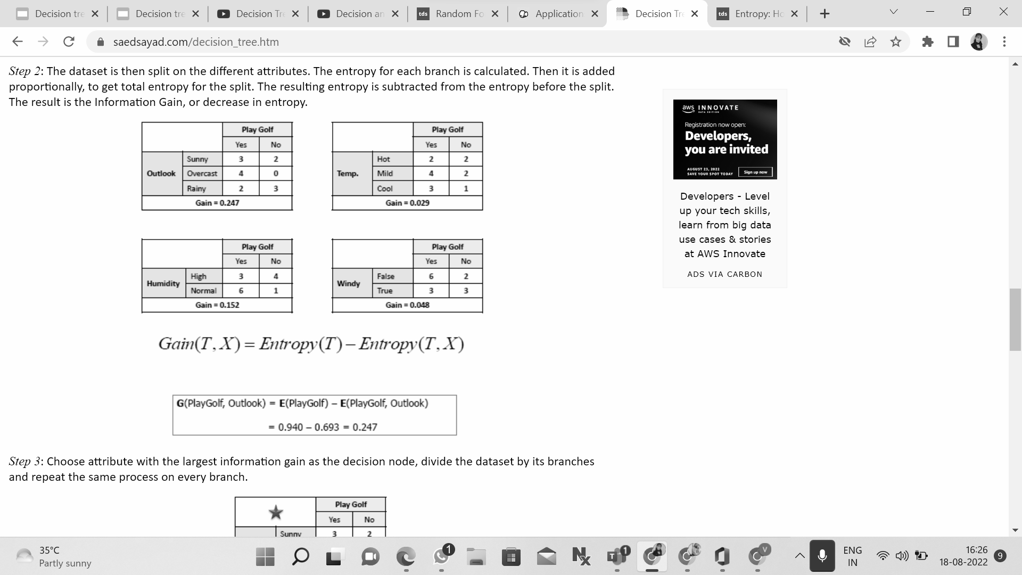
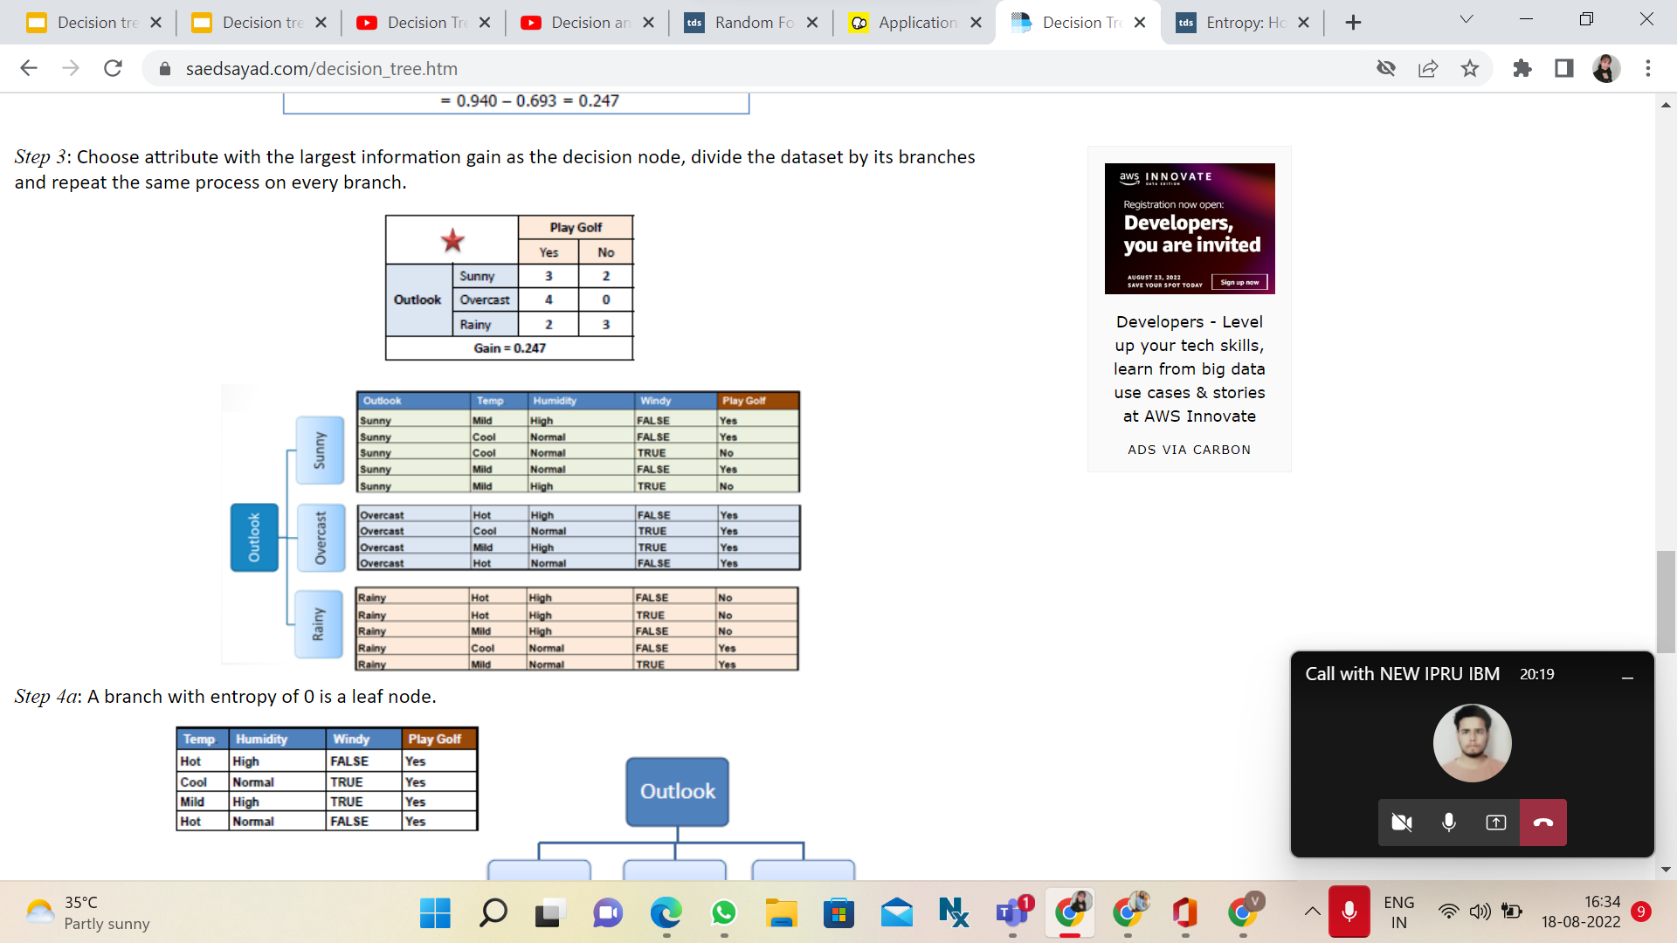
Step 4 - The resulting entropy is subtracted from the entropy before the split.
The result is the Information Gain.
Step 5 -Choose attribute with the largest information gain as the decision node, divide the dataset by its branches and repeat the same process on every branch.

Slide 17
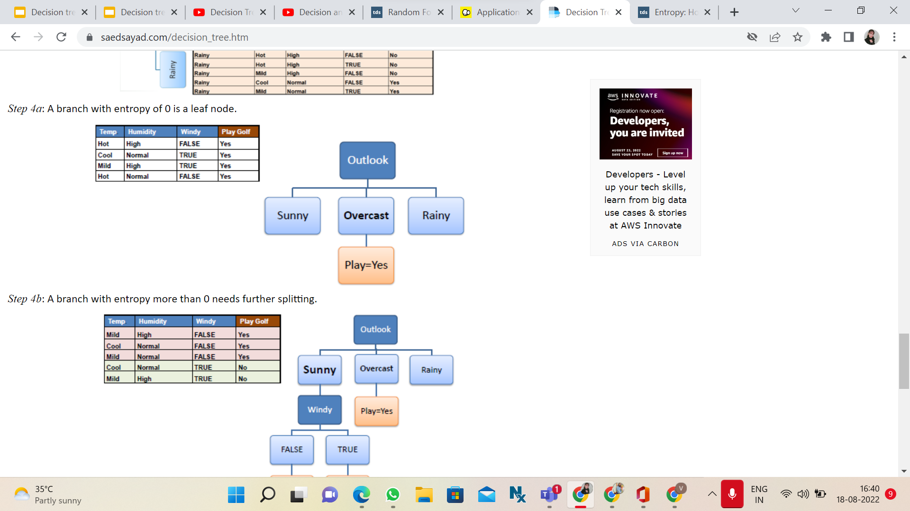
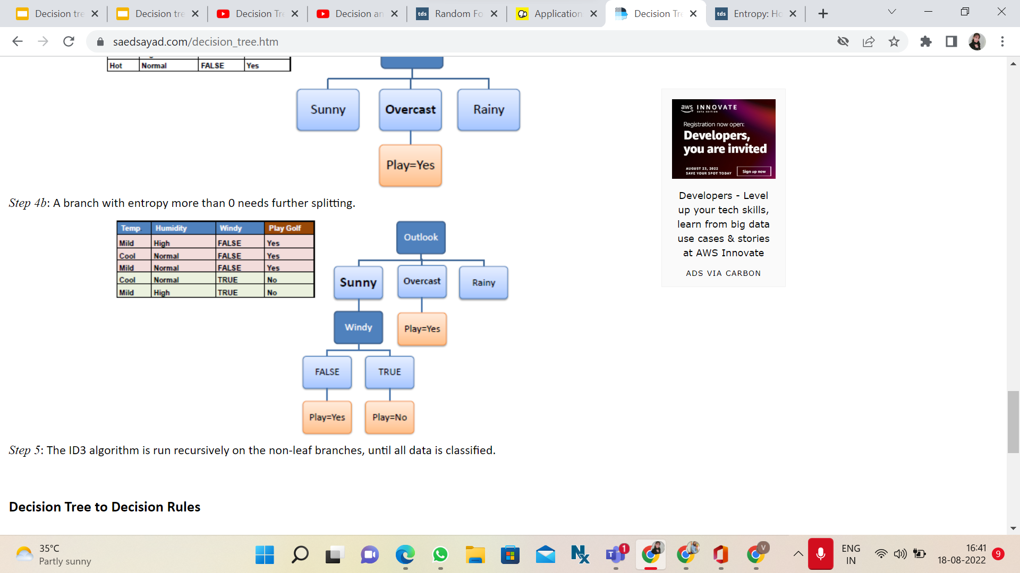
We go for Adding leaf nodes .

Slide 18
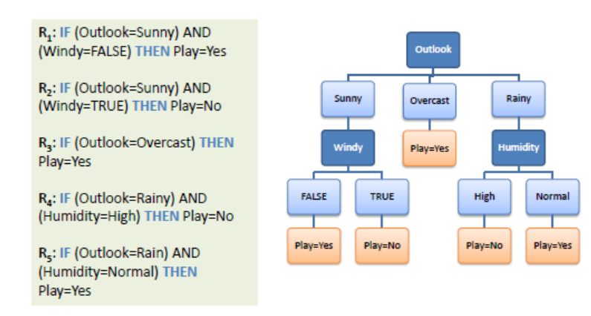
We finally got our Decision Tree.

Slide 19
Python Implementation
While implementing the decision tree we will go through the following two phases-
Building Phase
Preprocess the dataset.
Split the dataset from train and test using Python sklearn package.
Train the classifier.
Operational Phase
Make predictions.
Calculate the accuracy.

Slide 20
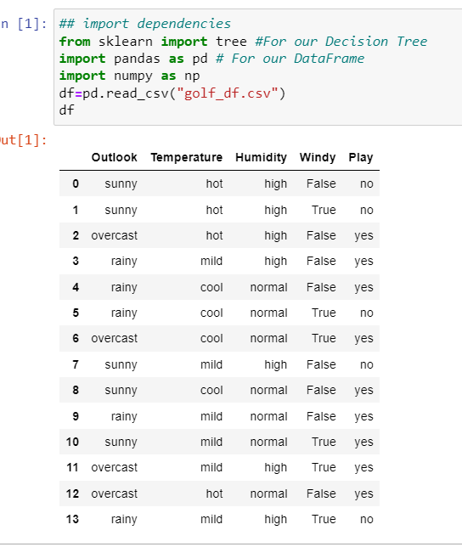
Data Processing
Importing libraries
Importing dataset

Slide 21
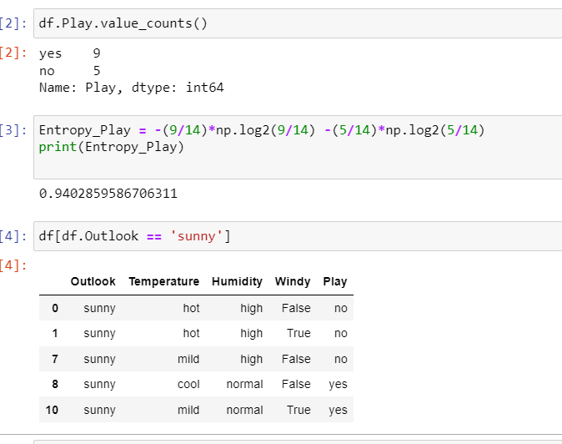
Applying entropy on play golf - our main outcome .
After this we will find attributes entropy -
Entropy(Play|Outlook=Sunny)

Slide 22
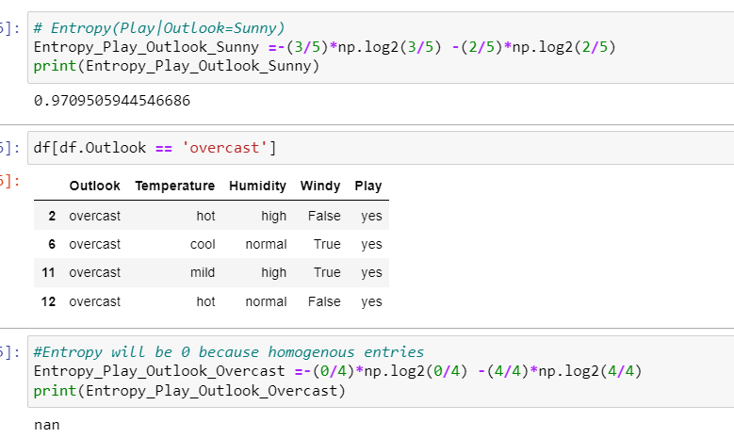
Here we have similar entries for overcast , so entropy outcome is null.

Slide 23
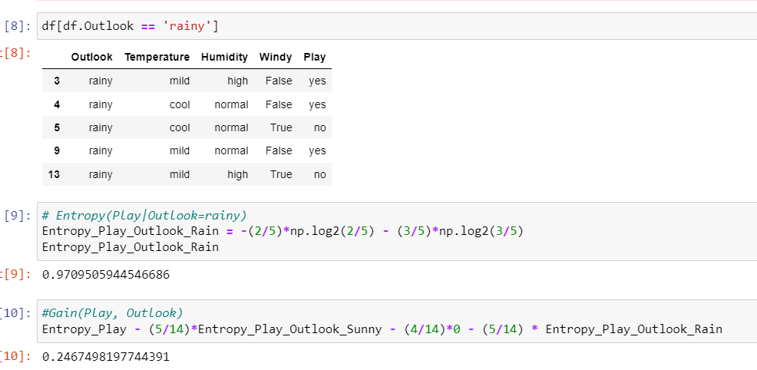

Slide 24
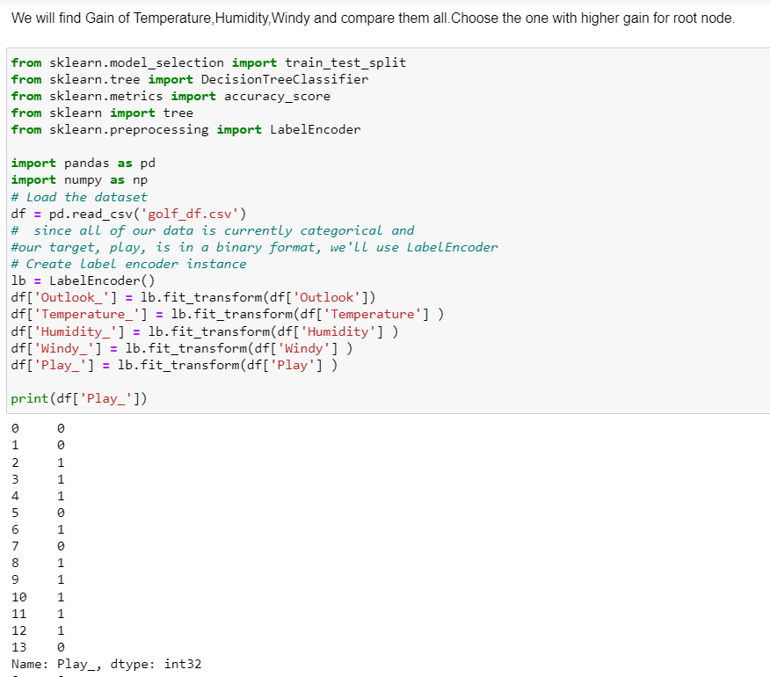
We will find Gain of temperature , humidity and windy and then compare all and choose the one with higher gain for root node.

Slide 25
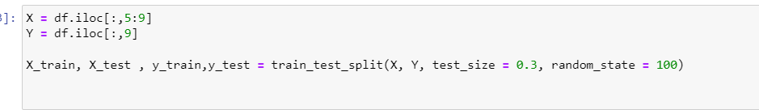
2. Creating test and train data set
Our data is now encoded properly, but we're still not ready for training.
Before we do anything with a Decision Tree model, we'll want to split our data into training and testing sets.

Slide 26
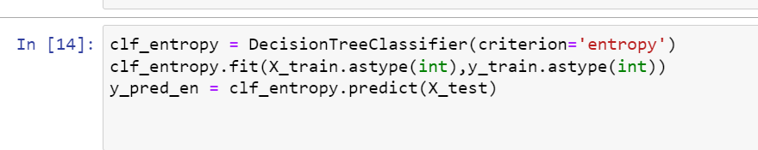
3. Train the classifier
We are using scikit-learn which has uniformity of its interfaces for every classifier--no matter what classifier we're using, we can expect it to have the same important methods such as .fit() and .predict().
We'll first create an instance of the classifier with any parameter values, and then we'll fit our data to the model using .fit() and make predictions with X_test using .predict().

Slide 27
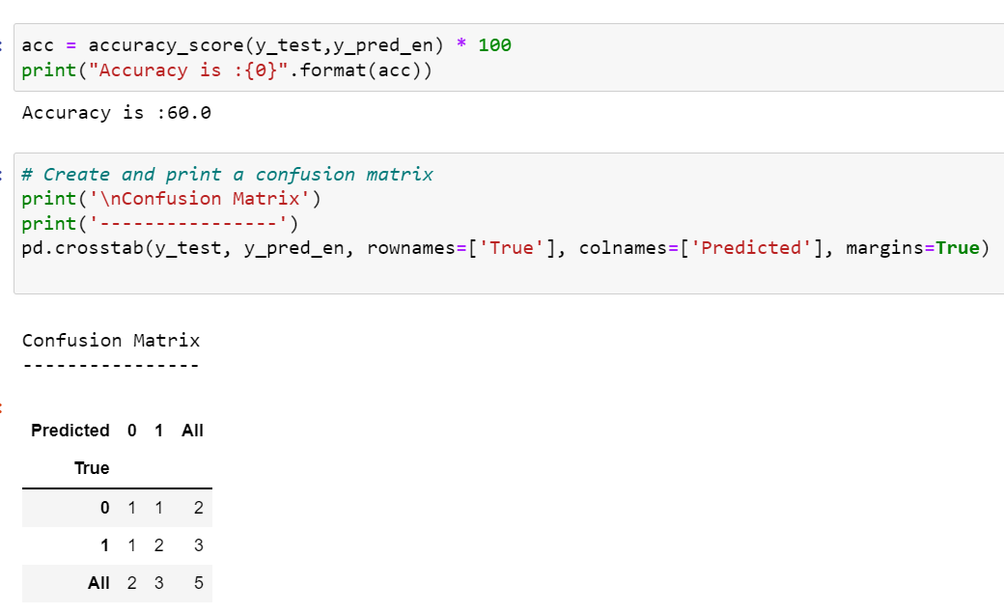
4. Make Prediction
And check Accuracy
We have a trained model and we've generated some predictions data set.
we will check for accuracy .
We can use a simple accuracy measure, AUC, a Confusion matrix, or all of them.

Slide 28
Advantage
Using decision trees in machine learning has several advantages:
The cost of using the tree to predict data decreases with each additional data point
Works for either categorical or numerical data
Can model problems with multiple outputs
Uses a white box model (making results easy to explain)
A tree’s reliability can be tested and quantified
Tends to be accurate regardless of whether it violates the assumptions of source data
Requires less effort for data preparation during pre-processing
Does not require normalization of data
Does not require scaling of data as well
Missing values do NOT affect the process
Very intuitive and easy to explain to technical teams as well as stakeholders

Slide 29
Disadvantage
A small change in the data can cause a large change in the structure; causing instability.
Sometimes calculation can go far more complex compared to other algorithms.
Often involves higher time to train the model.
Decision tree training is relatively expensive as the complexity and time has taken are more.
Inadequate for applying regression and predicting continuous values.

Slide 30
Hyperparameter Tuning:
https://scikit-learn.org/stable/modules/generated/sklearn.tree.DecisionTreeClassifier.html

Slide 31
2. RANDOM FOREST
Decision trees are easy to build ,easy to use and easy to interpret but in practice they are not that awesome.
The Elements of Statistical Learning (Aka the Bible of machine learning )states -
“ Trees have one aspect that prevents them from being the ideal tool for predictive learning namely in accuracy. “
In other words, they work great with the data used to create them but they are not flexible when it comes to classifying new samples .
Well Random Forests helps to combine the simplicity of decision trees with flexibility resulting in a vast improvement in accuracy.

Slide 32

Random Forest Tree Model

Slide 33
When should we use Random Forest ?
There are many domains where Random Forest Analysis can be used.
Some major Applications of Random Forest in different sectors:
Banking Industry
Credit Card Fraud Detection
Customer Segmentation
Predicting Loan Defaults on LendingClub.com
Healthcare and Medicine
Cardiovascular Disease Prediction
Diabetes Prediction
Breast Cancer Prediction
Stock Market
Stock Market Prediction
Stock Market Sentiment Analysis
Bitcoin Price Detection
E-Commerce
Product Recommendation
Price Optimization
Search Ranking

Slide 34
Why Should We Use Random Forest
Some of its advantages and important features why we use the Random forest Algorithm in machine learning.
Random forest algorithm is suitable for both classifications and regression task.
It gives a higher accuracy through cross validation.
Random forest classifier can handle the missing values and maintain the accuracy of a large proportion of data.
If there are more trees, it doesn’t allow over-fitting trees in the model.
It has the ability to work on a large data set with higher dimensionality.

Slide 35
Implementation
Step 1 - Create Bootstrap Dataset
Bootstrap Dataset -The Bootstrap refers to the resampling method in which several random samples are drawn with replacement from a dataset . As a consequence, Bootstrap creates multiple, smaller random datasets drawn from the same distribution.
The important detail is that we're allowed to pick the same sample more than once.

Slide 36
Implementation
Step 2 - For creating a random forest is to create a decision tree using the bootstrap dataset but only use a random subset of variables or columns at each step in.
Step 3 - Instead of considering all variables to figure out how to split the root node we randomly select any number of variable as candidates for the root node.
And assume that one did the best job separating the samples.
Step 4 - Now go back to step 1 and repeat make a new bootstrap data set and build a tree considering a subset of variables at each step.

Slide 37
Implementation
Step 5 - We will have a OUT-OF-BAG dataset and then run those data through out decision trees.
OUT-OF-BAG Dataset - This is the sample of dataset we did not use in creating our decision tree.
Step 6 - We keep the label (decision) of our out-of-bag data after running through decision tree .Since the label with the most votes wins is the label that we assign our out of bag sample in .
Step 7 - We do the same thing for all of the other out of bag samples for all of the trees.

Slide 38
Step 8 - Ultimately we can measure how accurate our random forest is by the proportion of out-of-bag samples that were correctly classified by the random forest.
The proportion of out-of-bag samples that were incorrectly classified is the out of bag error .
Each of the bootstrapped datasets is used to train a model, and the outputs are then Aggregated into one final result.
The technique of Bootstrap and Aggregation, commonly known as bagging.
NOTE - But aggregation also means different things, depending on the type of problem you’re solving.
When you’re working on a Regression problem, aggregation means averaging the results of each observation, across all models. While in Classification aggregation means picking the most common class for each observation, like doing a majority vote .

Slide 39
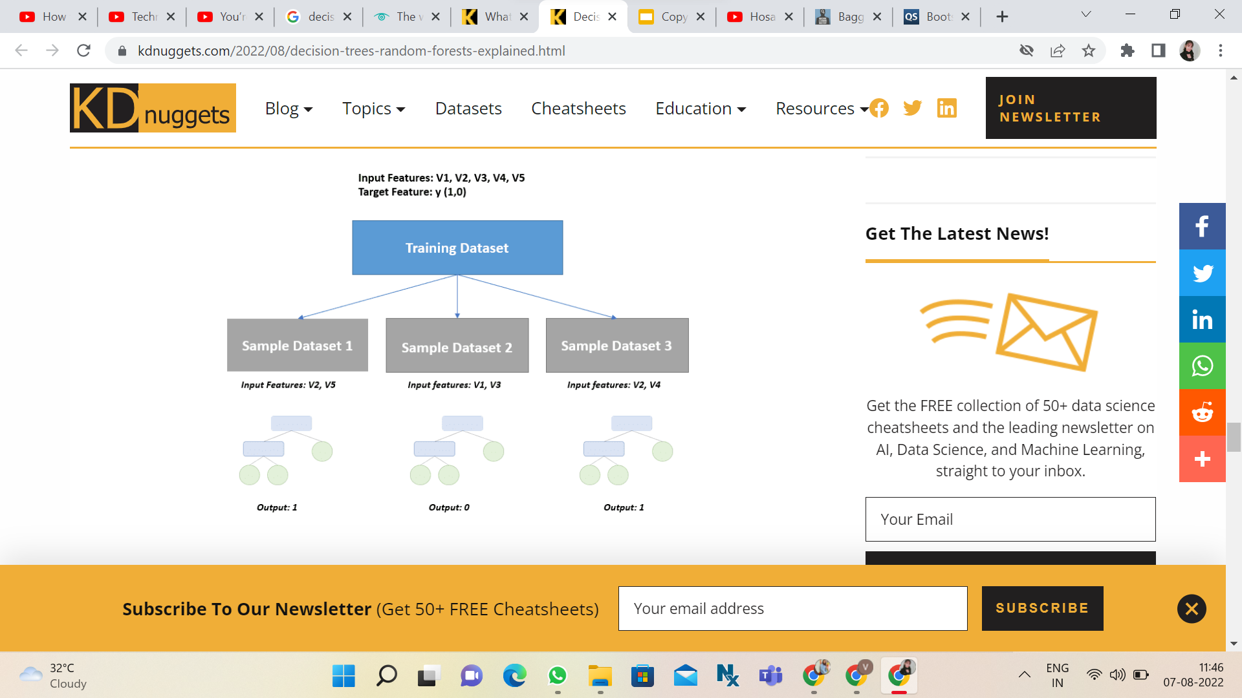
Working

Slide 40
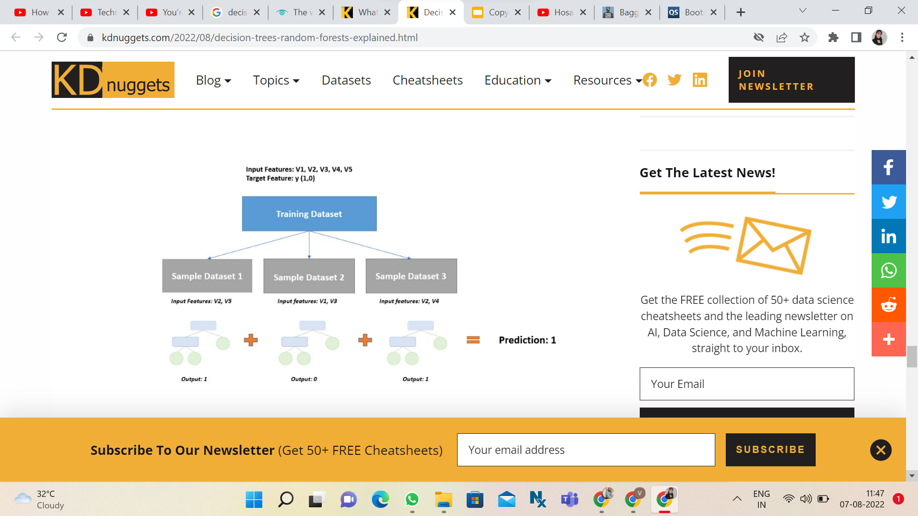
Working
Each decision tree will render different predictions based on the data sample they were trained on. So at the end we perform aggregation.

Slide 41
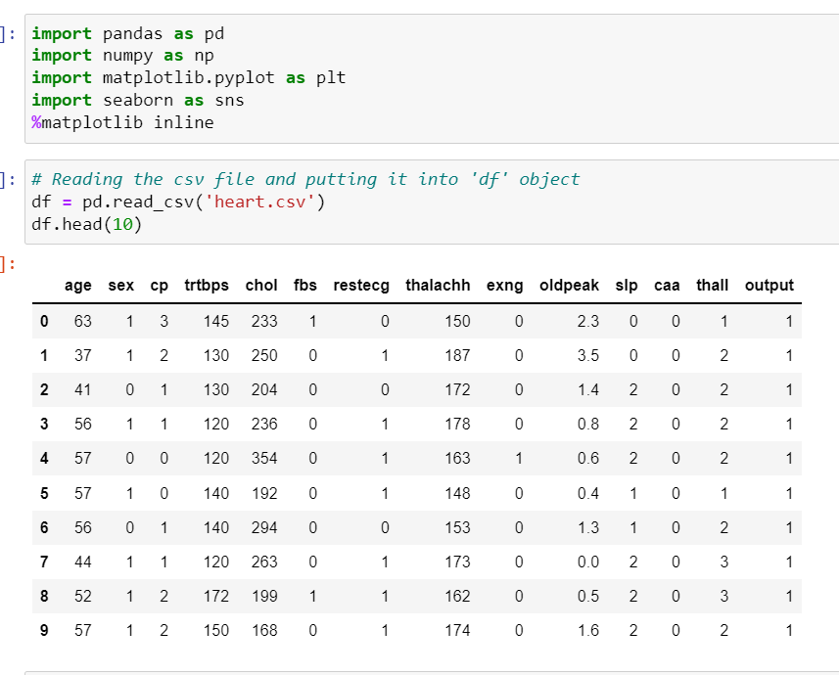
Python Implementation
Data Processing
Importing libraries
Importing dataset

Slide 42
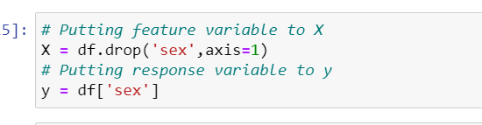
2. Putting Feature Variable to X and Target variable to y.
Before we construct the model, we need to understand how a classifier with a fixed set of assumptions could possibly be applied to many different problems.
This is possible because classifiers require the input data to be transformed into a form which matches the assumptions encoded in the classifier. This transformation is achieved using a set of features (a feature set), which are usually binary or continuous values

Slide 43
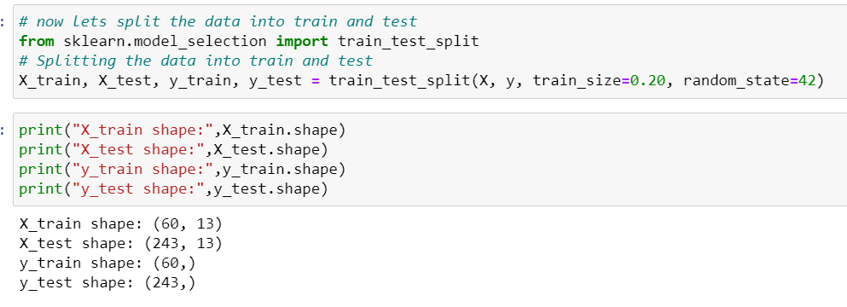
3. Train-Test-Split is performed

Slide 44
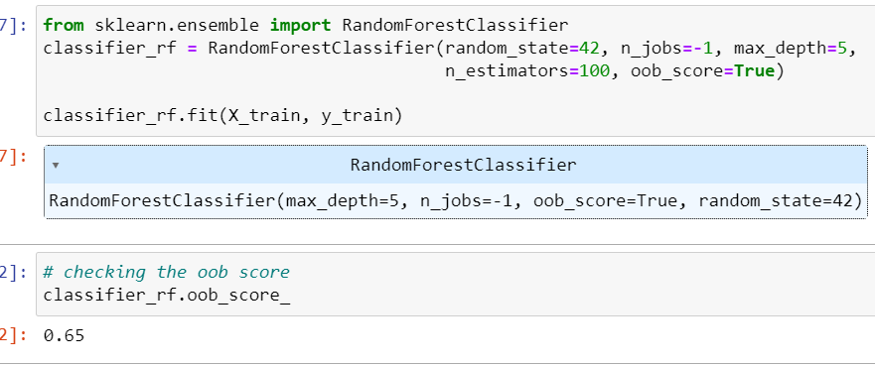
4. Import RandomForestClassifier and fit the data.

Slide 45
RandomForestClassifier
The Random forest classifier creates a set of decision trees from a randomly selected subset of the training set. It is basically a set of decision trees (DT) from a randomly selected subset of the training set and then It collects the votes from different decision trees to decide the final prediction.
oob_score_float
Score of the training dataset obtained using an out-of-bag estimate. This attribute exists only when oob_score is True.

Slide 46
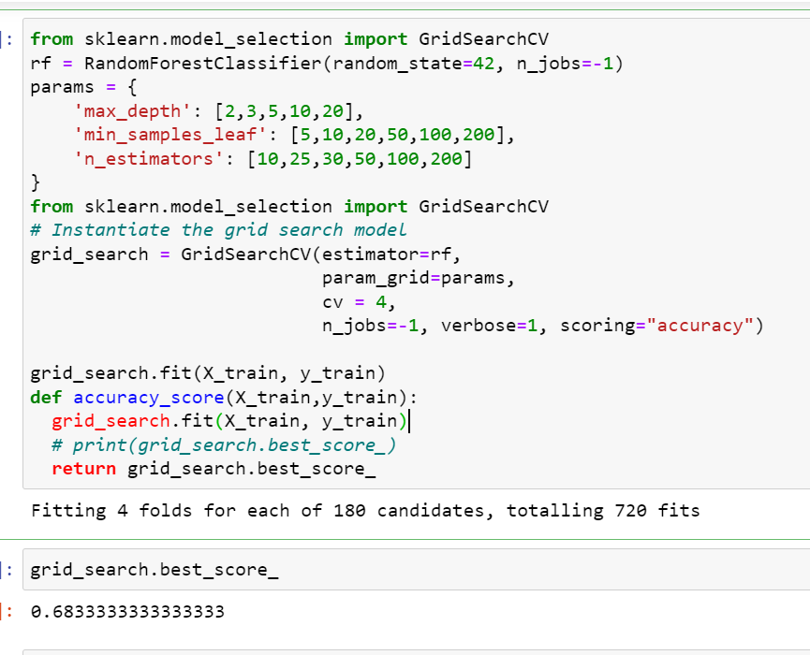
5 . Here we hyperparameter tuning for Random Forest using GridSearchCV and fit the data.

Slide 47
What is Hyperparameter Tuning ?
In machine learning, hyperparameter optimization or tuning is the problem of choosing a set of optimal hyperparameters for a learning algorithm. A hyperparameter is a parameter whose value is used to control the learning process. By contrast, the values of other parameters (typically node weights) are learned.
The best way to think about hyperparameters is like the settings of an algorithm that can be adjusted to optimize performance.
Using Scikit-Learn’s RandomizedSearchCV method, we can define a grid of hyperparameter ranges, and randomly sample from the grid, performing K-Fold CV with each combination of values.

Slide 48
We will try adjusting the following set of hyperparameters:
n_estimators = number of trees in the foreset
max_features = max number of features considered for splitting a node
max_depth = max number of levels in each decision tree
min_samples_split = min number of data points placed in a node before the node is split
min_samples_leaf = min number of data points allowed in a leaf node
bootstrap = method for sampling data points (with or without replacement)

Slide 49
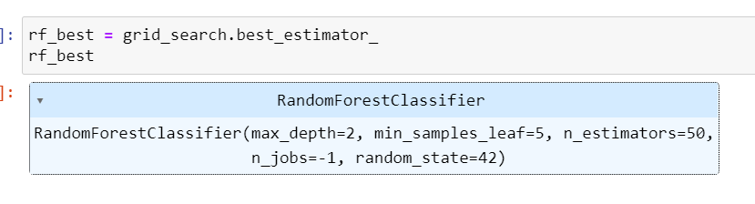
We also performed Grid Search : -
GridSearchCV is a technique to search through the best parameter values from the given set of the grid of parameters. Meaning instead of sampling randomly from a distribution, we evaluates all combinations we define. It is basically a cross-validation method. The model and the parameters are required to be fed in. Best parameter values are extracted and then the predictions are made.
From hyperparameter tuning, we can fetch the best estimator as shown. The best set of parameters identified were max_depth=2, min_samples_leaf=5, n_estimators=50

Slide 50
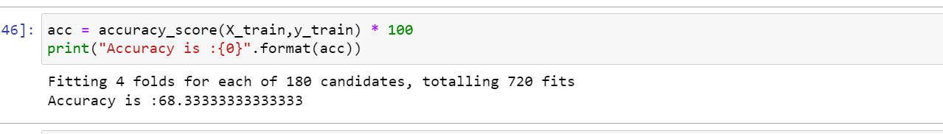
6. Accuracy Check
Accuracy of model = 68 %

Slide 51
Advantages:
Reduction in over-fitting and random forest classifier is more accurate than decision trees in most cases.
Disadvantages:
Slow real time prediction, difficult to implement, and complex algorithm.

Slide 52
Few of the limitations of Random forest are :
Correlated features will be given equal or similar importance, but overall reduced importance compared to the same tree built without correlated counterparts.
Random Forests and decision trees, in general, give preference to features with high cardinality ( Trees are biased to these type of variables ).

Slide 53
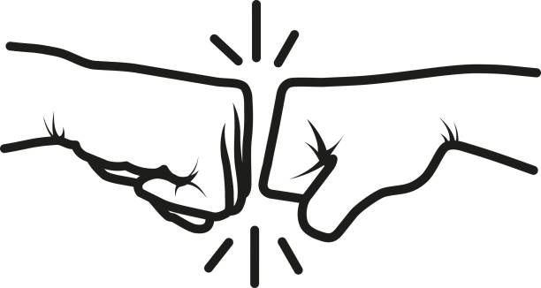
Decision Trees vs. Random Forests - Which One Is Better and Why?

Slide 54
Random forests typically perform better than decision trees due to the following reasons:
Random forests solve the problem of overfitting because they combine the output of multiple decision trees to come up with a final prediction.
When you build a decision tree, a small change in data leads to a huge difference in the model’s prediction. With a random forest, this problem does not arise since the data is sampled many times before generating a prediction.
In terms of speed, the random forests are slower since more time is taken to construct multiple decision trees. Adding more trees to a random forest model will improve its accuracy to a certain extent, but also increases computation time.
Finally, decision trees are also easier to interpret than random forests since they are straightforward. It is easy to visualize a decision tree and understand how the algorithm reached its outcome. A random forest is harder to deconstruct since it is more complex and combines the output of multiple decision trees to make a prediction.

Slide 55
THANK YOU

